Slide 1
FEF Puppet Implementation Project
Jason Allen
8/18/2010

Slide 2
Motivation
Managing ~3500 Linux nodes belonging to 10 different experiments.
FEF consists of 8 sysadmins and 2 managers
Majority of effort is resolving service requests.
Using Cfengine and home brew scripts for 6 years.

Slide 3
Issues with current tools
Poor package management
No reporting
Poor dependency management
Difficult to manage complex configurations
Difficult to read tool configs

Slide 4
Puppet
“Puppet is an open source data center automation and configuration management framework.”
Ruby based
Scalable to thousands of nodes
Web-based dashboard for reporting
Hundreds of community developed modules

Slide 5
Puppet
Very popular; in production at Los Alamos and being evaluated by BNL and US ATLAS.
We can think of machines in terms of functional roles.
Fine grained package management
Reporting tools allow us to audit current state of systems.
Faster resolution of service requests with fewer errors.
Better and faster system recovery

Slide 6
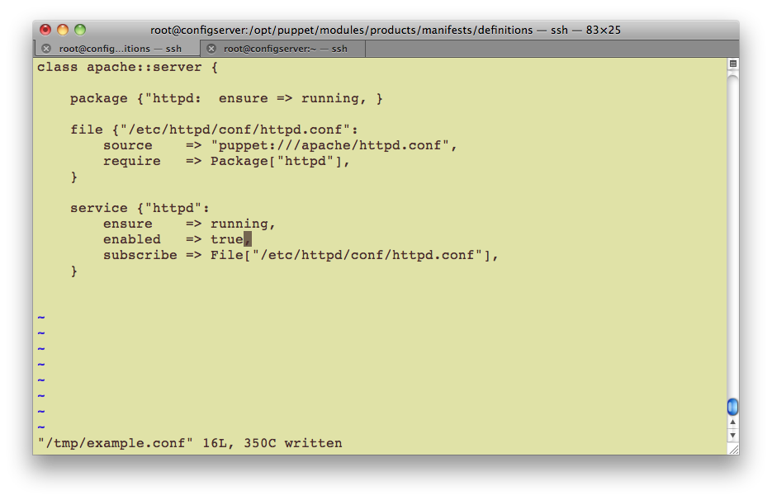
HTTPD Example

Slide 7
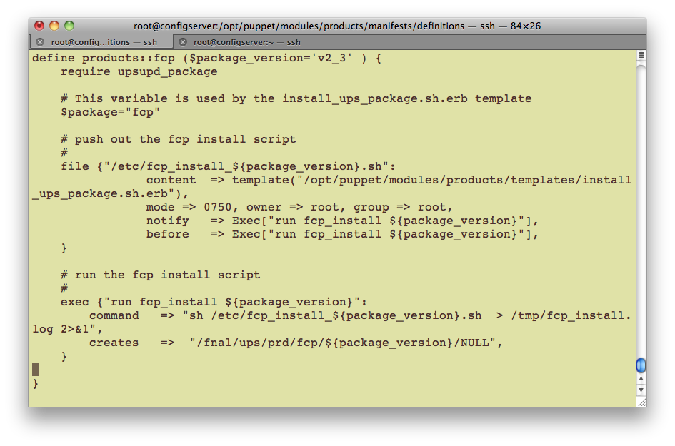
UPS Example

Slide 8
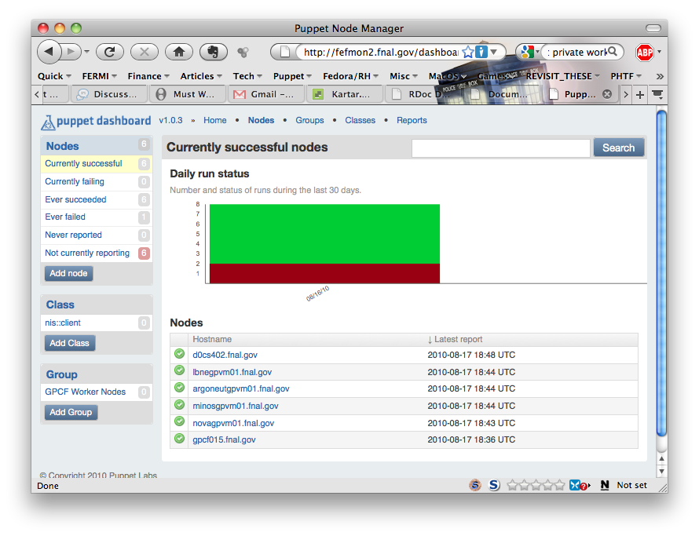
Puppet Dashboard

Slide 9
Where we are
Complete: GPCF pilot program
Complete: Scalability testing
Complete: Schema design
In progress: IF experiment migration
Sept - Nov: D0 and CDF Offline migration

Slide 10
Resources
FEF Configuration Management Tools Comparison DocDB #3967
FEF Puppet Implementation Overview DocDB #3979
http://www.puppetlabs.com/puppet/introduction/
Ed Simmonds

